Slide 1

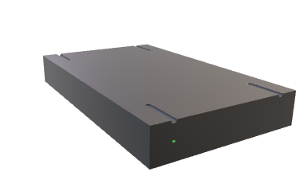

4
Send AC
Sensitive Server
8
3
5
Create AC related to PK
9
Send role in associated AC
Store AC
Verify access rule for role
7
Send PK
AC Issuer
AC Repository
10
6
Establish communication
Send PK
2
Send PK
Alice PC
1
Create PK

Slide 2
Real Attribute Certificate Structure
Attribute Certificate
Version | the version of the certificate
Holder | the holder of the certificate
Issuer | the issuer of the certificate.
Signature algorithm | the algorithm by which the certificate is signed
Serial number | the unique issuance number given by the issuer
Validity period | the validity period of the certificate
Attributes | the attributes associated to the certificate holder
Signature value | the signature of the issuer over the whole data above
Public Key Certificate | The public key certificate of the holder

Slide 3
Our Attribute Certificate Structure
Attribute Certificate
Version | the version of the certificate
Holder | the holder of the certificate
Issuer | the issuer of the certificate.
Signature algorithm | the algorithm by which the certificate is signed
Serial number | the unique issuance number given by the issuer
Validity period | the validity period of the certificate
Attributes | the attributes associated to the certificate holder
Signature value | the signature of the issuer over the whole data above
Public Key | The public key of the holder

